Slide 1

Building & Mining Knowledge Graphs
(KEN4256)
Lab 5: Interlinking and Advanced Querying
Amrapali Zaveri, Vincent Emonet

Slide 2
Attendance
http://tinyurl.com/y2rghjsk

Slide 3
Linked Data Principles
Use Uniform Resource Identifiers (URIs) as names for things.
Use HTTP URIs, so that people can look up those names.
When someone looks up a URI, provide useful information, using the standards (RDF, RDFS, OWL, SPARQL).
Include links to other URIs, so that they can discover more things.

Slide 4
Linked Data Principles
Use Uniform Resource Identifiers (URIs) as names for things.
Use HTTP URIs, so that people can look up those names.
When someone looks up a URI, provide useful information, using the standards (RDF, RDFS, OWL, SPARQL).
Include links to other URIs, so that they can discover more things.

Slide 5
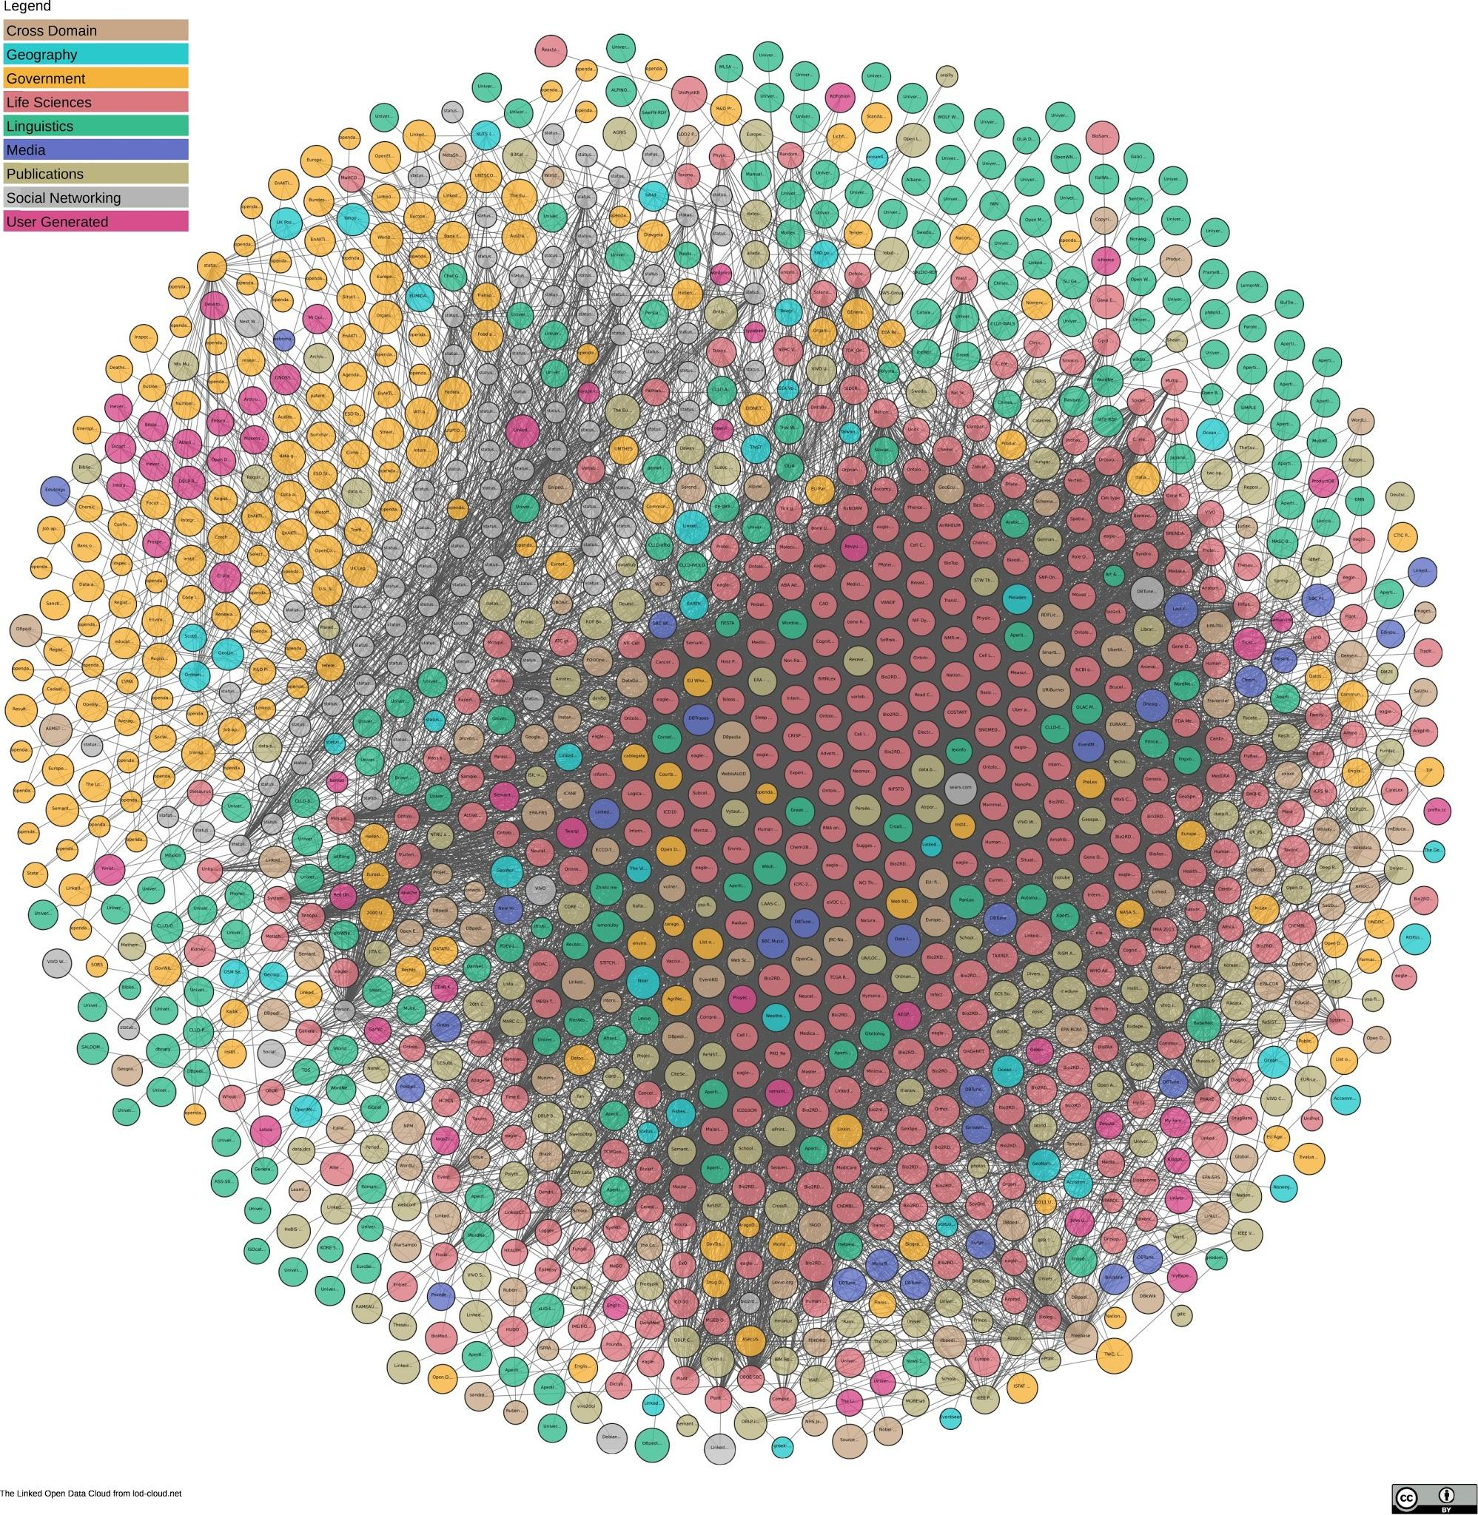
https://lod-cloud.net/
1,224 datasets
with 16,113 links
(as of June 2018)
Notes:
DBpedia is nucleus of LOD

Slide 6
Interlinking Datasets
an external RDF link is an RDF triple in which the
subject of the triple is a URI reference in the namespace of one data set,
while the predicate and/or object of the triple are URI references pointing into the namespaces of other data sets.
Example:
<http://worldbank.org/India>
<http://www.w3.org/2002/07/owl#sameAs>
<http://dbpedia.org/resource/India>
Notes:
namespaces

Slide 7
Types of Links
Relationship Links point at related things in other data sources, for instance, other people, places or genes.
Example: ex:Amrapali foaf:knows ex:Tim-BernersLee
Identity Links point at URI aliases used by other data sources to identify the same real-world object or abstract concept.
Example: wb:India owl:sameAs db:India
Vocabulary Links point from data to the definitions of the vocabulary terms that are used to represent the data, as well as from these definitions to the definitions of related terms in other vocabularies. Vocabulary links make data self-descriptive and enable Linked Data applications to understand and integrate data across vocabularies.
Example: dbo:Country rdfs:subClassOf dbo:PopulatedPlace

Slide 8
Considerations before Interlinking
What is the added value of the data in the target data set?
Is the target data set and its namespace under stable ownership and active maintenance?
Are the URIs in the data set stable and unlikely to change?
Are there outgoing links to other data set so that applications can tap into a network of interconnected data sources?

Slide 9
Choosing Predicates for Linking
How widely is the predicate already used for linking by other data sources?
Is the vocabulary well maintained and properly published with dereferenceable URIs?
How semantically accurate is the relationship? Are the entities the same or are they related?
Examples:
owl:sameAs
skos:broader
skos:narrower

Slide 10
Automatic Interlinking

Slide 11
Link Discovery - Similarity-based Approaches
Goal: Discover related entities across knowledge bases
Use similarity-based linkage heuristics, which may compare multiple properties of the entities that are to be interlinked as well as properties of related entities
Example: Linking entities in GeoNames and DBpedia by comparing
the names of places using a string similarity function
longitude and latitude values using a geographic matcher
name of the country in which the places are located
population count

Slide 12
Link Discovery Tools
LIMES – Link Discovery Framework for Metric Spaces provides time-efficient approaches for discovery and computing the results of link specifications.
Silk - A Link Discovery Framework for the Web of Data tool for discovering relationships between data items within different Linked Data sources. Data publishers can use Silk to set RDF links from their data sources to other data sources on the Web.
TopBraid Composer (ontology editor made by TopQuadrant) has a wizard for linking ontology instances to corresponding DBpedia concepts.
SemMF is a framework for calculating semantic similarity between objects that are represented as arbitrary RDF graphs. The framework allows taxonomic and non-taxonomic concept matching techniques to be applied to selected object properties.

Slide 13
Interlinking using LIMES tool
(Link Discovery Framework for Metric Spaces)
https://github.com/dice-group/LIMES/releases download JAR file

Slide 14
Configuration File
Metadata
<?xml version="1.0" encoding="UTF-8"?> <!DOCTYPE LIMES SYSTEM "limes.dtd"> <LIMES>
Prefixes
<PREFIX> <NAMESPACE>http://www.w3.org/1999/02/22-rdf-syntax-ns#</NAMESPACE> <LABEL>rdf</LABEL> </PREFIX>
Notes:
Six properties need to be set.
Each data source must be given an ID via the tag ID.
The endpoint of the data source needs to be explicated via the ENDPOINT tag.
If the data is to be queried from a SPARQL end point, the ENDPOINT tag must be set to the corresponding SPARQL endpoint URI.
In case the data is stored in a local file (CSV, N3, TURTLE, etc.), ENDPOINT tag must be set to the absolute path of the file containing the data.
The VAR tag describes the variable associated with the aformentioned endpoint. This variable is also used later, when specifying the metric used to link the entities retrieved from the source and target endpoints.
The fourth property is set via the PAGESIZE tag. This property must be set to the maximal number of triples returned by the SPARQL endpoint. For example, the DBpedia endpointreturns a maximum of 1000 triples for each query. LIMES' SPARQL module can still retrieve all relevant instances for the mapping even the value is set. If the SPARQL endpoint does not limit the number of triples it returns or if the input is a file, the value of PAGESIZE should be set to -1.
The restrictions on the queried data can be set via the RESTRICTION tag. This tag allows to constrain the entries that are retrieved the LIMES' query module. In this particular example, we only use instances of MESH concepts. Additionally, multiple RESTRICTION tags are allowed per data source.
The PROPERTY tag allows to specify the properties that will be used during the linking. It is important to note that the property tag can also be used to specify the preprocessing on the input data. For example, setting rdfs:label AS nolang, one can ensure that the language tags get removed from each rdfs:label before it is written in the cache. Pre-processing functions can be piped into one another by using ->. For example, rdfs:label AS nolang->lowercase will compute lowercase(nolang(rdfs:label)). If you are not sure if all your entities have a certain property you can use the OPTIONAL_PROPERTY tag instead of PROPERTY. Additionally, multiple PROPERTY tags are allowed per data source

Slide 15
Configuration File
Data Sources - Source
<SOURCE> <ID>dbpedia</ID> <ENDPOINT>http://dbpedia.org/sparql</ENDPOINT> <VAR>?y</VAR> <PAGESIZE>5000</PAGESIZE> <RESTRICTION>?y rdf:type dbo:City</RESTRICTION> <PROPERTY>rdfs:label</PROPERTY> <TYPE>sparql</TYPE> </SOURCE>

Slide 16
Configuration File
Data Sources - Target
<TARGET> <ID>graphdb</ID>
<ENDPOINT>http://linkedgeodata.org/sparql</ENDPOINT> <VAR>?x</VAR> <PAGESIZE>5000</PAGESIZE> <RESTRICTION>?x rdf:type lgd:City</RESTRICTION> <PROPERTY>rdfs:label</PROPERTY> </TARGET>

Slide 17
Configuration File
Metric
<METRIC> levenshtein(x.rdfs:label, y.rdfs:label) </METRIC>

Slide 18
Configuration File
Acceptance & Review Conditions
<ACCEPTANCE> <THRESHOLD>0.95</THRESHOLD> <FILE>accepted.nt</FILE> <RELATION>owl:sameAs</RELATION> </ACCEPTANCE>
<REVIEW> <THRESHOLD>0.60</THRESHOLD> <FILE>reviewme.nt</FILE> <RELATION>owl:sameAs</RELATION> </REVIEW>

Slide 19
Configuration File
Output Format
<OUTPUT>N3</OUTPUT>
End file
</LIMES>

Slide 20
Execute LIMES
java -jar path/to/limes-core-${version}-SNAPSHOT.jar path/to/{configuration-file}.xml

Slide 21
Output
<http://dbpedia.org/resource/Amsterdam> <http://www.w3.org/2002/07/owl#sameAs> <http://linkedgeodata.org/triplify/node268396336> .
<http://dbpedia.org/resource/Berlin> <http://www.w3.org/2002/07/owl#sameAs> <http://linkedgeodata.org/triplify/node240109189> .
Notes:
SPARQL Query for interlinking

Slide 22
Questions?

Slide 23
Resources
Linked Data Book http://linkeddatabook.com/editions/1.0/
When owl:sameAs isn’t the Same: An Analysis of Identity Links on the Semantic Web https://www.w3.org/2009/12/rdf-ws/papers/ws21
Interlinks in DBpedia: https://wiki.dbpedia.org/services-resources/interlinking
How to publish Linked Data on the Web: http://wifo5-03.informatik.uni-mannheim.de/bizer/pub/LinkedDataTutorial/

Slide 24
Querying Knowledge Graphs SPARQL Part 2
http://dbpedia.org/sparql

Slide 25
Functions: cast to float
Compute countries density: error due to wrong type
SELECT ?country ?area ?population (?population/?area AS ?density) WHERE { ?country a dbo:Country ; dbo:populationTotal ?population ; <http://dbpedia.org/ontology/PopulatedPlace/areaTotal> ?area . FILTER(?area != 0) }

Slide 26
Functions: cast to float
Convert a variable to a specific type
Here compute countries density
SELECT ?country ?area ?population (xsd:float(?population)/xsd:float(?area) AS ?density) WHERE { ?country a dbo:Country ; dbo:populationTotal ?population ; <http://dbpedia.org/ontology/PopulatedPlace/areaTotal> ?area . FILTER(?area != 0) }

Slide 27
Functions: langMatches
Filter retrieved variable on its lang
Here get the Dutch name of Oceanian countries
SELECT ?country ?countryName WHERE { ?country a dbo:Country ; dbp:continent ?continent ; rdfs:label ?countryName . FILTER(str(?continent) = "Oceania") FILTER langMatches( lang(?countryName), "NL" ) }
Notes:
Also working: FILTER (lang(?countryName) = "nl" )

Slide 28
Many more functions
isLiteral, STRSTARTS, CONTAINS, ENCODE_FOR_URI, REPLACE, MD5 hashing...
An comprehensive specification of SPARQL can be found here:
https://www.w3.org/TR/sparql11-query/

Slide 29
Count
Counts the number of times a given expression has a value
Count the number of bands in each music genre
SELECT ?genre count(?band) as ?count WHERE { ?band a dbo:Band . ?band dbo:genre ?genre . } order by desc(?count)
Be careful count can be really expensive to run!

Slide 30
Optional
Do not filter on this pattern, return the value if exists.
Get countries from Oceania and display the dissolution date of this country if they have one.
SELECT ?country ?dissolutionDate WHERE { ?country a dbo:Country . ?country dbp:continent ?continent . OPTIONAL { ?country dbo:dissolutionDate ?dissolutionDate . } FILTER(str(?continent) = "Oceania") }

Slide 31
Subqueries
Queryception: a query inside a query
Order the first 10 countries to have been dissolved by date of creation.
Select all countries that have been dissolved
Order them by dissolution date (oldest to newest)
Limit to 10
Finally, order the results (countries) from the most recently created to the oldest created
Notes:
Do it on an aggregate: it is where it is more interesting to optimize the query (do first the limit, then the order by)

Slide 32
Subqueries
SELECT * WHERE { { SELECT ?country ?dissolutionDate WHERE { ?country a dbo:Country . ?country dbo:dissolutionDate ?dissolutionDate . } order by ?dissolutionDate limit 10 } ?country dbo:foundingYear ?foundingYear . } order by desc(?foundingYear)
Order countries by dissolution date and keep the 10 first
Order them from the most recently created to the oldest created

Slide 33
Questions?

